Slide 1
These blue flags appear throughout the presentation and contain instructions and tips.
Delete these notes before presenting.
Add organization-specific information to this slide.
Survey Workshop for <Customer name>
DD Month YYYY

Slide 2
Agenda
Optional: Insert start times for agenda items.
Duration guidelines are:
Opening remarks - 5 min.
SGMM overview - 35 min.
Guidelines - 10 min.
SGMM Compass Survey completion - 240 min.
Wrap up and next steps - 10 min.
Opening remarks
Smart Grid Maturity Model overview
Compass Survey guidelines and preparations
Compass Survey completion
Wrap up and next steps
Breaks will be held at appropriate intervals Lunch will be provided

Slide 3
Opening remarks
Replace this slide with opening remarks from the Sponsor or delete.

Slide 4
Agenda
Optional: Insert start times for agenda items.
Duration guidelines are:
Opening remarks - 5 min.
SGMM overview - 35 min.
Guidelines - 10 min.
SGMM Compass Survey completion - 240 min.
Wrap up and next steps - 10 min.
Opening remarks
Smart Grid Maturity Model overview
Compass Survey guidelines and preparations
Compass Survey completion
Wrap up and next steps
Breaks will be held at appropriate intervals Lunch will be provided

Slide 5

A major power grid transformation is underway
How can utilities
Develop effective roadmaps?
Track progress?
Understand their posture in comparison to peers?
The Smart Grid Maturity Model was developed by utilities to address these concerns

Slide 6
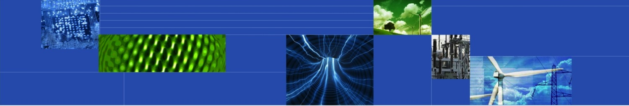
The Smart Grid Maturity Model is
A management tool
that provides a
common language and framework
for defining key elements of
smart grid transformation
and helping utilities develop a
programmatic approach
and track their progress

Slide 7
SGMM timeline
2007 |  | 2008 |  | 2009 |  | 2010 |  | 2011 |  | 2012 - 2016 |  | 2017 |  | 2018 |  | …
Global Intelligent Utility Network Coalition (GIUNC) develops SGMM
Utilities use SGMM v1.0
v1.1
v1.2
SGMM public release
Software Engineering Institute becomes model steward
SGMM Open Assess-ment Event
GIUNC:
CenterPoint Energy
Progress Energy
DONG Energy
North Delhi Power Ltd
Country Energy
Sempra Energy
Pepco Holdings
IBM
APQC
SEI releases SGMM v1.1 product suite
Licensing & certification program for SGMM Navigation begins
SEI releases SGMM v1.2 product suite
Developed by utilities, for utilities

Slide 8


The Software Engineering Institute
The SEI is a federally-funded research and development center at Carnegie Mellon University, a global university recognized worldwide for its energy and environmental research initiatives.
A trusted, objective source of best practices, methods and tools to organizations worldwide, the SEI is a global leader in software and systems engineering, process improvement and security best practices – all critical elements of smart grid success.
The SEI collaborates in public-private partnership with government and industry on important cyber security, architecture, and interoperability challenges of the smart grid.

Slide 9


The SEI’s Role as Steward of the SGMM
Provide governance working with multiple stakeholders
Enable widespread availability, adoption, and use of the model for the benefit of the community
Evolve the model based on stakeholder needs, market developments, user feedback, and interactions with domain experts
Develop transition mechanisms—education, training, awareness, research collaboration— to support the model
Grow the SGMM community of users worldwide

Slide 10
SGMM at a glance
6 Maturity Levels: Defined sets of characteristics and outcomes
5
4
3
175 Characteristics: Features you would expect to see at each stage of the smart grid journey
2
1
0
SMR Strategy, Management, & Regulatory
OS Organization & Structure
GO Grid Operations
WAM Work & Asset Management
TECH Technology
CUST Customer
VCI Value Chain Integration
SE Societal & Environmental
8 Domains: Logical groupings of smart grid related characteristics

Slide 11
Smart Grid Maturity Model – levels
PIONEERING
Breaking new ground; industry-leading innovation
OPTIMIZING
Optimizing smart grid to benefit entire organization; may reach beyond organization; increased automation
INTEGRATING
Integrating smart grid deployments across the organization, realizing measurably improved performance
ENABLING
Investing based on clear strategy, implementing first projects to enable smart grid (may be compartmentalized)
INITIATING
Taking the first steps, exploring options, conducting experiments, developing smart grid vision
DEFAULT
Default level (status quo)

Slide 12
Smart Grid Maturity Model – domains
SMR
Strategy, Mgmt & Regulatory
TECH
Technology
Vision, planning, governance, stakeholder collaboration
IT architecture, standards, infrastructure, integration, tools
OS
Organization and Structure
CUST
Customer
Culture, structure, training, communications, knowledge mgmt
Pricing, customer participation & experience, advanced services
GO
Grid Operations
VCI
Value Chain Integration
Reliability, efficiency, security, safety, observability, control
Demand & supply management, leveraging market opportunities
WAM
Work & Asset Management
SE
Societal & Environmental
Asset monitoring, tracking & maintenance, mobile workforce
Responsibility, sustainability, critical infrastructure, efficiency

Slide 13

Model | Fully described in the Model Definition document
Compass Survey | Questionnaire-based assessment yields maturity ratings and comparisons
Navigation Process | Defined process to complete Compass to build a common understanding and set aspirations across the organization
V 1.2 Product Suite
To download the SGMM product suite, go to
https://resources.sei.cmu.edu/library/asset-view.cfm?assetid=512758

Slide 14
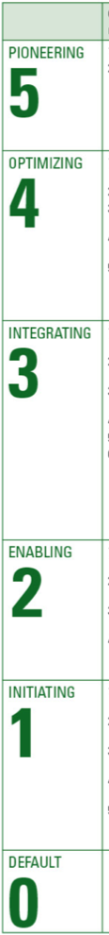
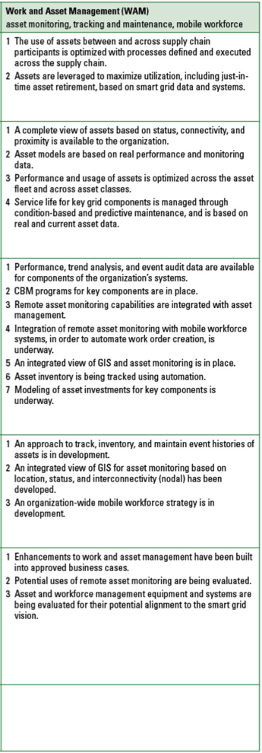
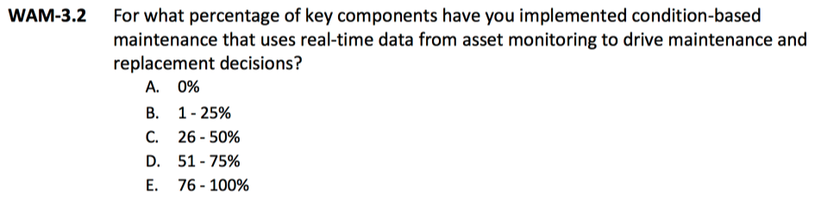
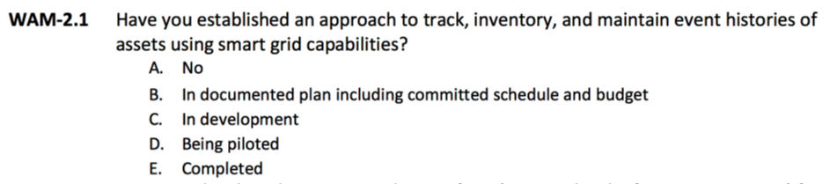
SGMM Compass Survey
WAM
Work and Asset Management
Contains
One question for each expected characteristic in the model and
Attribute and performance questions
Example questions:
WAM-3.2 Condition-based maintenance programs for key components are in place.
WAM-2.1 An approach to track, inventory, and maintain event histories of assets is in development.

Slide 15





SGMM Navigation: five-phase, expert-led process
Stakeholders complete SGMM Compass survey
Discussion and consensus answers lead to internal alignment on current state
Stakeholders review survey findings & set aspirational profile
Consensus on aspirational state and identification of motivations, actions, and obstacles to achieve it

Slide 16
Compass results: maturity profile example results
3
3
2
2
2
2
1
SGMM maturity profile includes a maturity score for each domain
0

Slide 17
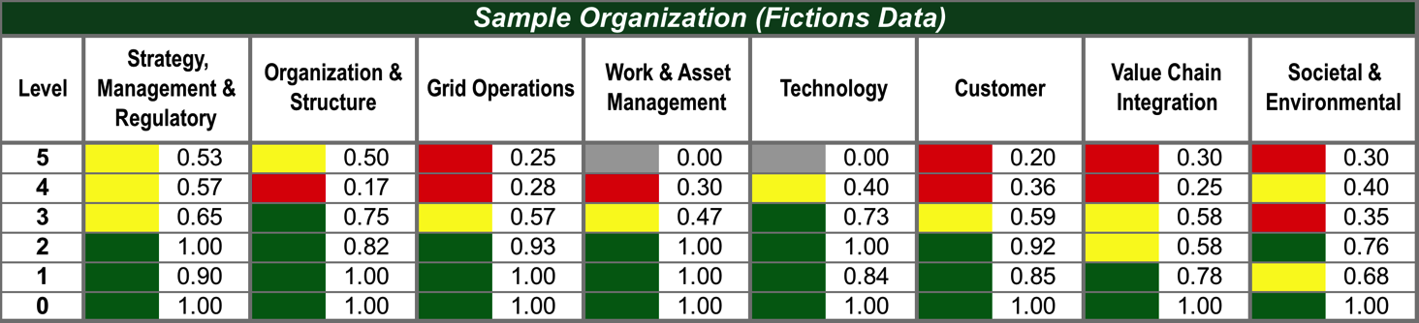
Compass results: dashboard example results
Sample Results
 | Point Range | Meaning
 | ≥ 0.70 | Green reflects level compliance within the domain
 | ≥ 0.40 and < 0.70 | Yellow reflects significant progress
 | < 0.40 | Red reflects initial progress
 | = 0 | Grey reflects has not started

Slide 18
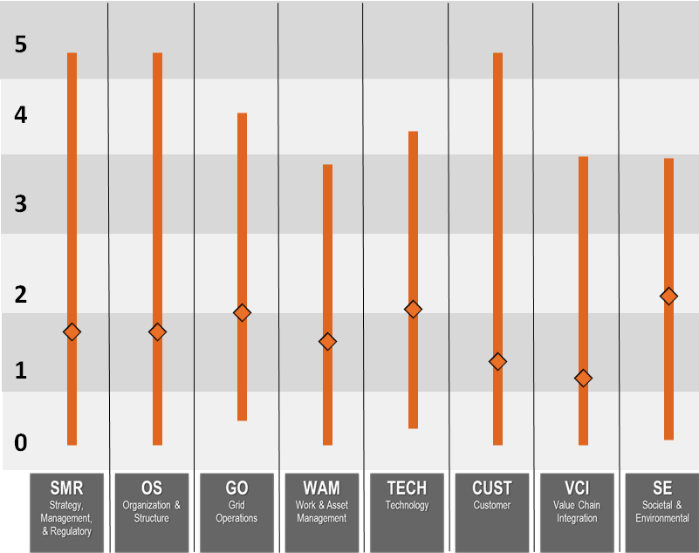
Compass results: peer community comparison example results
Orange bars are peer community ranges
Orange diamonds are peer community averages
Green squares are utility ratings (example results)

Slide 19
Strategy, Mgmt, & Regulatory
Legend: Top 10-33% Bottom 33% Top 10% Red Italics Weakness against the model
5 |  | 5.3 New business model opportunities emerge as a result of smart grid capabilities and are implemented.
 |  | 5.2 Smart grid business activities provide sufficient financial resources to enable continued investment in smart grid sustainment and expansion.
 |  | 5.1 Smart grid strategy capitalizes on smart grid as a foundation for the introduction of new services and product offerings.
4 |  | 4.3 Smart grid strategy is shared and revised collaboratively with external stakeholders.
 |  | 4.2 Smart grid is a core competency throughout the organization.
 |  | 4.1 Smart grid vision and strategy drive the organization’s strategy and direction.
3 |  | 3.4 Required authorizations for smart grid investments have been secured.
 |  | 3.3 Smart grid leaders with explicit authority across functions and lines of business are designated to ensure effective implementation of the smart grid strategy.
 |  | 3.2 A smart grid governance model is established.
 |  | 3.1 The smart grid vision, strategy, and business case are incorporated into the vision and strategy.
2 |  | 2.6 There is support and funding for conducting proof-of-concept projects to evaluate feasibility and alignment.
 |  | 2.5 There is collaboration with regulators and other stakeholders regarding implementation of the smart grid vision and strategy.
 |  | 2.4 Budgets are established specifically for funding the implementation of the smart grid vision.
 |  | 2.3 Operational investment is explicitly aligned to the smart grid strategy.
 |  | 2.2 A common smart grid vision is accepted across the organization.
 |  | 2.1 An initial smart grid strategy and a business plan are approved by management.
1 |  | 1.3 Discussions have been held with regulators about the organization’s smart grid vision.
 |  | 1.2 Experimental implementations of smart grid concepts are supported.
 |  | 1.1 Smart grid vision is developed with a goal of operational improvement.
Example results Fictitious organization
Aspiration setting:
Model characteristics are sequentially reviewed, discussed, and considered for levels that have not yet been achieved.
Consensus on relevance and importance to organization for achieving characteristics is used to set aspiration.

Slide 20
Strategy, Mgmt, & Regulatory
Aspiration Setting Tool
Example results Fictitious organization
5
4
3
2
1
0
What motivates this aspiration?
What actions must happen to achieve this aspiration?
What obstacles must be overcome to achieve this aspiration?
Aspiration
Current

Slide 21
Navigation results: consensus aspirations example results
This is where we aspire to be in X years
4
4
4
3
3
3
3
3
2
2
2
2
2
2
This is where we are today
1
NOTE: There is no “correct” target profile implied in the model; the optimal profile will vary by utility.
0

Slide 22
SGMM benefits – a community view
Use of SGMM by utilities
Utilities
Guidance, common language, & means to track progress
SGMM Partners
Product to help customers and participation in roadmap development
DOE
Another mechanism to support grid modernization
SEI
Maturity & Performance Data
“What works” patterns to inform strategies, services, & programs.
Correlations of performance to maturity patterns and other analyses
Demonstrations of the value of grid modernization.
Improvements to SGMM product suite.

Slide 23
Agenda
Insert start times for agenda items.
Duration guidelines are:
Opening remarks - 5 min.
SGMM overview - 35 min.
Guidelines - 10 min.
SGMM Compass Survey completion - 240 min.
Wrap up and next steps - 10 min.
Opening remarks
Smart Grid Maturity Model overview
Compass Survey guidelines and preparations
Compass Survey completion
Wrap up and next steps
Breaks will be held at appropriate intervals Lunch will be provided

Slide 24

Navigation process
✔
Today
A five-step process lead by a certified SGMM Navigator
Preparations are completed, first four Compass survey sections are completed
Survey Workshop: stakeholders from utility complete the Compass survey as a team, discussions occur to develop consensus on responses
Navigator analyzes results and prepares findings
Aspirations Workshop: Compass results and findings are presented and discussed; aspirations for planning horizon are agreed through consensus discussions
Actions are planned and documentation is completed to conclude the process

Slide 25
Guidelines for completing the Survey -1
Include scope in guideline 1.
Answers for this survey are for <scope of the assessment> only.
Every question must be answered. If it appears a question does not pertain to your organization, answer it in the context of your role in realizing that capability across your value chain.
There can be only one answer per question. Select the one that most matches your situation.
The time frame for answering questions is today. Don’t answer questions based on what might happen in the future.
Answer options are a continuum. Select the answer option that most matches your situation. When torn between two options, consider using the lesser option to better track progress.

Slide 26
Guidelines for completing the Survey -2
Some questions are compound, (e.g., privacy and security); you must consider both options together.
Consider the maturity level as context for the question, (e.g., level 4 questions assume that a smart grid is in place).
A person will be selected as a tie-breaker for each domain. If consensus cannot be reached for a question, the tie-breaker will select the answer.

Slide 27
Tie-breakers
SMR
Strategy, Mgmt & Regulatory
TECH
Technology
Vision, planning, governance, stakeholder collaboration
IT architecture, standards, infrastructure, integration, tools
Tie-breaker:
Tie-breaker:
OS
Organization and Structure
CUST
Customer
Culture, structure, training, communications, knowledge mgmt
Pricing, customer participation & experience, advanced services
Tie-breaker:
Tie-breaker:
GO
Grid Operations
VCI
Value Chain Integration
Reliability, efficiency, security, safety, observability, control
Demand & supply management, leveraging market opportunities
Tie-breaker:
Tie-breaker:
WAM
Work & Asset Management
SE
Societal & Environmental
Asset monitoring, tracking & maintenance, mobile workforce
Responsibility, sustainability, critical infrastructure, efficiency
Tie-breaker:
Tie-breaker:

Slide 28
Guidelines for participation
The group should strive to listen to all participants to understand all views and ideas and to offer support when other participants need help or further clarification.
All participants should be fully engaged throughout all process activities to ensure that their views and ideas are known and understood.
If you feel a question or answer could be improved, please comment. Suggestions will be considered for future model improvements.
Group members should discuss questions so that answers can be selected that best reflect the consensus view.
All participants should focus on maintaining an effective and productive environment during the survey process.

Slide 29
Agenda
Insert start times for agenda items.
Duration guidelines are:
Opening remarks - 5 min.
SGMM overview - 35 min.
Guidelines - 10 min.
SGMM Compass Survey completion - 240 min.
Wrap up and next steps - 10 min.
Opening remarks
Smart Grid Maturity Model overview
Compass Survey guidelines and preparations
Compass Survey completion
Wrap up and next steps
Breaks will be held at appropriate intervals Lunch will be provided

Slide 30
Begin Compass Survey

Slide 31
Agenda
Insert start times for agenda items.
Duration guidelines are:
Opening remarks - 5 min.
SGMM overview - 35 min.
Guidelines - 10 min.
SGMM Compass Survey completion - 240 min.
Wrap up and next steps - 10 min.
Opening remarks
Smart Grid Maturity Model overview
Compass Survey guidelines and preparations
Compass Survey completion
Wrap up and next steps
Breaks will be held at appropriate intervals Lunch will be provided

Slide 32
Navigation process
Insert date (mm/dd)
✔
Today
Mm/dd
A five-step process lead by a certified SGMM Navigator
Preparations are completed, first four Compass survey sections are completed
Survey Workshop: stakeholders from utility complete the Compass survey as a team, discussions occur to develop consensus on responses
Navigator analyzes results and prepares findings
Aspirations Workshop: Compass results and findings are presented and discussed; aspirations for planning horizon are agreed through consensus discussions
Actions are planned and documentation is completed to conclude the process

Slide 33
Contact information
Insert contact information; delete placeholders as needed
<navigator name>
<navigator title>
<navigator email>
<navigator phone>
<person 2 name>
<person 2 title>
<person 2 email>
<person 2 phone>
<person 3 name>
<person 3 title>
<person 3 email>
<person 3 phone>
www.sei.cmu.edu/smartgrid

Slide 34
Notices
Copyright 2018 Carnegie Mellon University. All rights reserved. This material is based upon work funded and supported by the Department of Defense under Contract No. FA8721-05-C-0003 with Carnegie Mellon University for the operation of the Software Engineering Institute, a federally funded research and development center. Any opinions, findings and conclusions or recommendations expressed in this material are those of the author(s) and do not necessarily reflect the views of the United States Department of Defense. NO WARRANTY. THIS MATERIAL IS FURNISHED ON AN “AS-IS” BASIS WITH NO WARRANTIES OF ANY KIND, EITHER EXPRESSED OR IMPLIED, INCLUDING, BUT NOT LIMITED TO, WARRANTY OF FITNESS FOR PURPOSE OR MERCHANTABILITY, ANY WARRANTY WITH RESPECT TO FREEDOM FROM PATENT, TRADEMARK, OR COPYRIGHT INFRINGEMENT, OR THIRD PARTY INTELLECTUAL PROPERTY RIGHTS. [Distribution Statement A] This material has been approved for public release and unlimited distribution. The United States Government has Unlimited Rights in this material as defined by DFARS 252.227-7013.
The text and illustrations in this material are licensed by Carnegie Mellon University under a Creative Commons Attribution 4.0 International License.
The Creative Commons license does not extend to logos, trade marks, or service marks of Carnegie Mellon University.

Slide 35
Back up slides
SGMM Navigation Process

