Slide 1
CERT BFF:
From Start to PoC
Will Dormann

Slide 2
Copyright
Copyright 2016 Carnegie Mellon University
This material is based upon work funded and supported by Department of Homeland Security under Contract No. FA8721-05-C-0003 with Carnegie Mellon University for the operation of the Software Engineering Institute, a federally funded research and development center sponsored by the United States Department of Defense.
Any opinions, findings and conclusions or recommendations expressed in this material are those of the author(s) and do not necessarily reflect the views of Department of Homeland Security or the United States Department of Defense.
References herein to any specific commercial product, process, or service by trade name, trade mark, manufacturer, or otherwise, does not necessarily constitute or imply its endorsement, recommendation, or favoring by Carnegie Mellon University or its Software Engineering Institute.
NO WARRANTY. THIS CARNEGIE MELLON UNIVERSITY AND SOFTWARE ENGINEERING INSTITUTE MATERIAL IS FURNISHED ON AN “AS-IS” BASIS. CARNEGIE MELLON UNIVERSITY MAKES NO WARRANTIES OF ANY KIND, EITHER EXPRESSED OR IMPLIED, AS TO ANY MATTER INCLUDING, BUT NOT LIMITED TO, WARRANTY OF FITNESS FOR PURPOSE OR MERCHANTABILITY, EXCLUSIVITY, OR RESULTS OBTAINED FROM USE OF THE MATERIAL. CARNEGIE MELLON UNIVERSITY DOES NOT MAKE ANY WARRANTY OF ANY KIND WITH RESPECT TO FREEDOM FROM PATENT, TRADEMARK, OR COPYRIGHT INFRINGEMENT.
[Distribution Statement A] This material has been approved for public release and unlimited distribution. Please see Copyright notice for non-US Government use and distribution.
This material may be reproduced in its entirety, without modification, and freely distributed in written or electronic form without requesting formal permission. Permission is required for any other use. Requests for permission should be directed to the Software Engineering Institute at permission@sei.cmu.edu.
CERT® is a registered mark of Carnegie Mellon University.
DM-0003661

Slide 3
CERT BFF
Fuzzing Basics

Slide 4


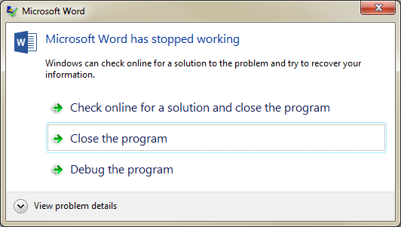
Mutational Fuzzing
Mutation
Fuzzer
Microsoft
Word
Notes:
Basic mutational fuzzing takes a file, mutates it, and looks for which mutations cause the target application to crash.

Slide 5

The CERT BFF
* It’s not you, it’s me

Slide 6
The CERT Basic Fuzzing Framework
* It’s not you, it’s me

Slide 7
How BFF Works
Pick with a seed file
Mangle the file
Launch target application
Look for crashes
Analyze crash
Repeat
Do this blindly, but as as intelligently as possible
Notes:
Conceptually, black-box mutational fuzzing is quite simple. But BFF strives to do it as intelligently as possible, using feedback loops for learning.

Slide 8
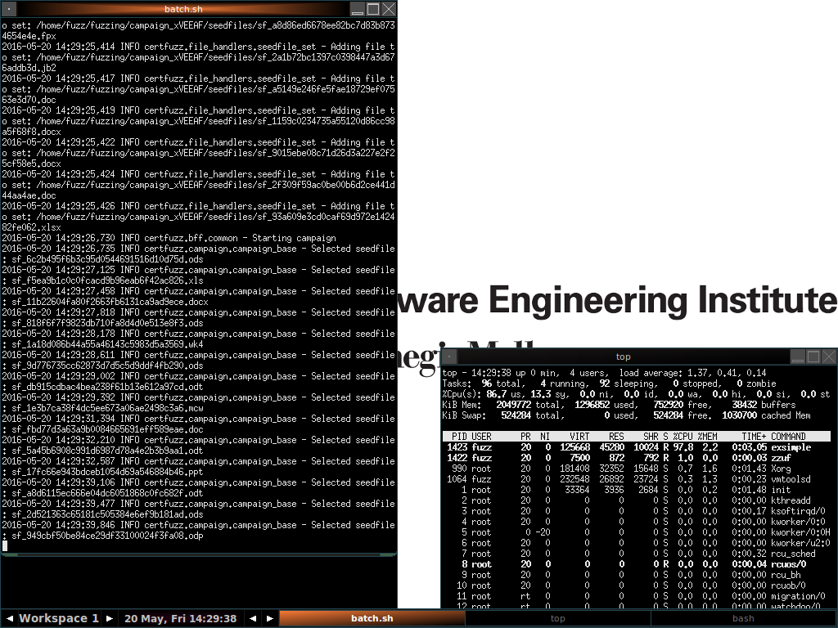
CERT BFF In Action
Notes:
Here’s a screenshot of the UbuFuzz VM, fuzzing a target.

Slide 9
CERT BFF
Picking a Target

Slide 10
Oracle Outside In
“Oracle Outside In Technology provides software developers with a comprehensive solution to access, transform, and control the contents of over 500 unstructured file formats. From the latest office suites, such as Microsoft Office 2007, to specialty formats and legacy files, Outside In Technology provides software developers with the tools to transform unstructured files into controllable information.”
http://www.oracle.com/us/technologies/embedded/025613.htm
Notes:
Swiss army knives expose a large attack surface.

Slide 11
What Uses Oracle Outside In?
Microsoft Exchange
Google Search Appliance
Guidance Encase Forensics
Access Data FTK
Novell Groupwise
Cisco Security Agent
McAfee GroupShield
Symantec Enterprise Vault
IBM WebSphere
…
Notes:
And many more…

Slide 12
Fuzzing Oracle Outside In
Notes:
Here we see BFF fuzzing different parsers of Outside In: ODS, DOCX, and WK4, including more.

Slide 13
CERT BFF
Investigating Results

Slide 14
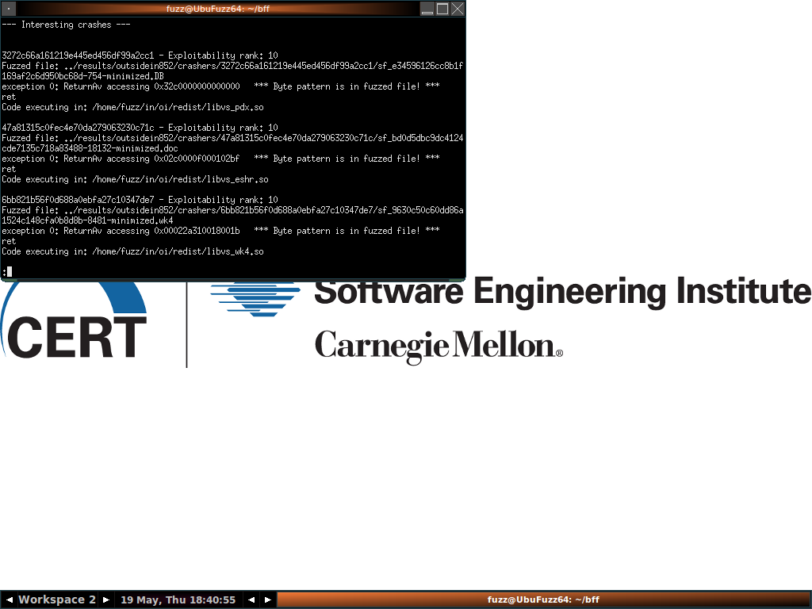
Checking Results with tools/drillresults.py
Notes:
Run tools/drillresults.py to find interesting (from a perspective of gaining control of the instruction pointer) crashes. Scores range from 1 – 100, with a lower score being the best. Currently, a “10” is the best (most exploitable) crash.
In the highlighted case, there is an access violation on the RET instruction, and the byte pattern of the AV exists verbatim in the fuzzed file.

Slide 15
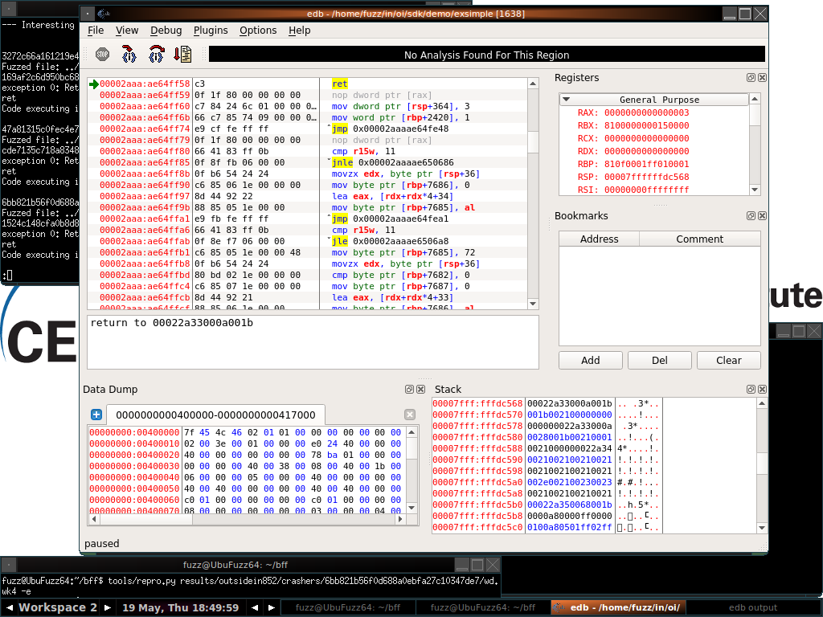
Run tools/repro.py -e
Notes:
Gdb is hard to use. UbuFuzz comes with Evan’s Debugger, which is point-and-click. Run tools/repro.py <crasher> -e to reproduce the crasher with edb.
Here we see that the Return is to the address reported by drillresults.py. This also confirms that the crash is reproducible and reliable.

Slide 16
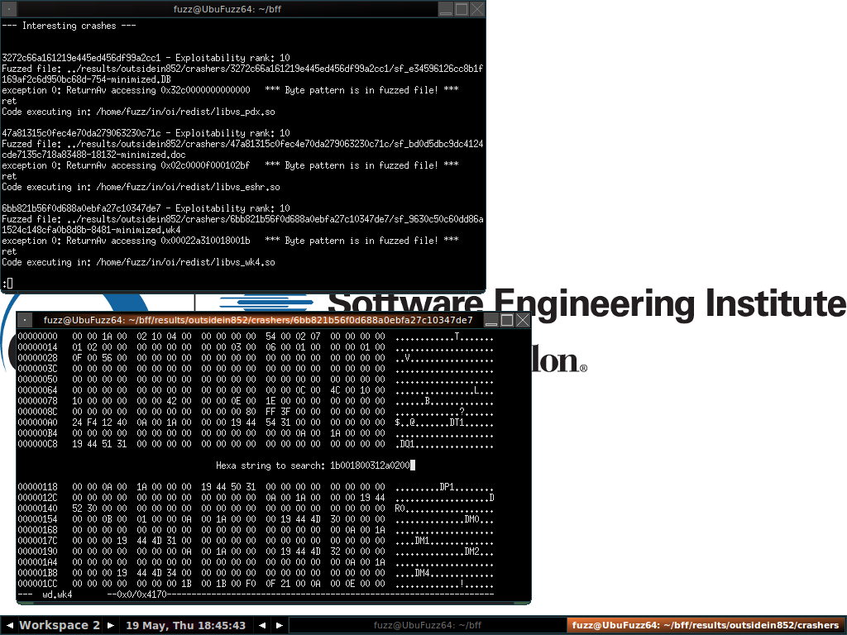
Finding Matching Byte Pattern
Notes:
We can open our fuzzed file in a hex editor to find the AV pattern.

Slide 17
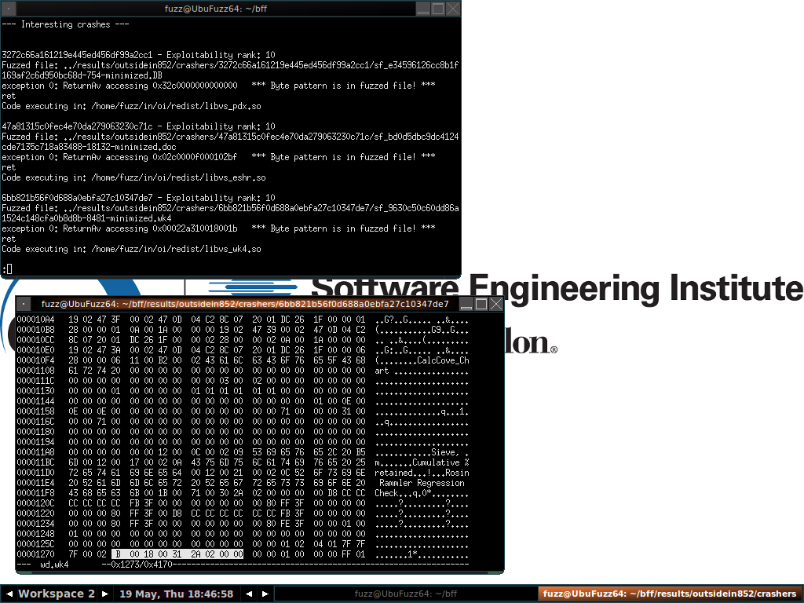
Finding Matching Byte Pattern
Notes:
We’ve found a match! We can try editing this to confirm that we have control of the RET.

Slide 18
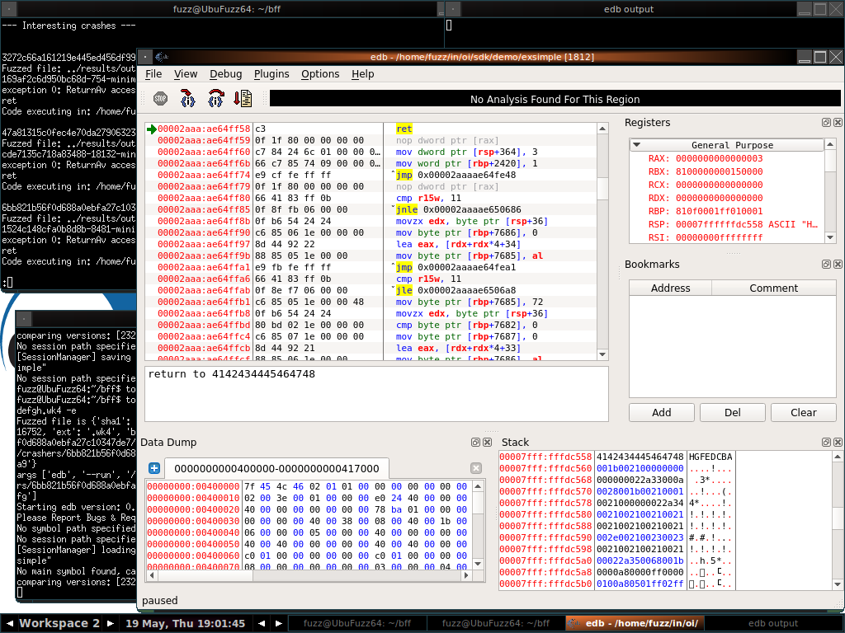
Confirming Control of RET
Notes:
Once we modify the fuzzed file to attempt control of the RET, we reproduce with edb and confirm our attempt. We are now trying to return to the memory location ABCDEFGH (0x4847464544434241). This demonstrates that we have control of the instruction pointer.

Slide 19
CERT BFF
Writing a PoC

Slide 20
Minimize to string
Standard minimization gives the minimally-different-from-seed-file test case. But which of those bytes are irrelevant to the crash?
We want to know:
  Bytes required for processing (Structure)
  Bytes required to trigger crash (Vulnerability)
Notes:
When turning a crashing test case into a proof-of-concept exploit, we need to know which bytes we can modify.

Slide 21
What Minimize-to-String Does
original byte
fuzzed byte
crash byte
Known good seedfile – does not cause crash
non-structure byte
Fuzz
Fuzzed file – causes crash, many changed bytes are not involved in the crash
Minimize-to-string
Minimized-to-string file – causes same crash, replaces non-structure bytes
insert shellcode here
Notes:
CERT BFF string minimization (tools/minimize.py –s) lets you know what bytes are irrelevant to the crash, and therefore should be able to be modified to any value.

Slide 22

Minimization to String, Visualized
Notes:
This is an animated visualization of what happens during BFF string minimization. Here we’re minimizing to ‘x’ (tools/minimize.py –s –x), so BFF repeatedly attempts to see which bytes can be changed to ‘x’ and still reproduce the same crash. The end result is a file that retains the structure and crash-producing bytes, while indicating the irrelevant bytes as ‘x’ (0x78)

Slide 23
Writing a Memory Corruption PoC
Two pieces of information are required:
  What bytes are under my control?
  How do I get there?
Notes:
When we’ve got control of the instruction pointer, turning a crashing test case into a PoC requires these two pieces of information:
What bytes are under my control? (e.g., where is my shellcode)
How do I get there?

Slide 24
The Crash
What bytes do I control?
How do I get there?
Notes:
Looking again at our crashing testcase:
What bytes are under my control? (e.g., where can I put my shellcode)
How do I get there?
It’s not clear in this case.

Slide 25
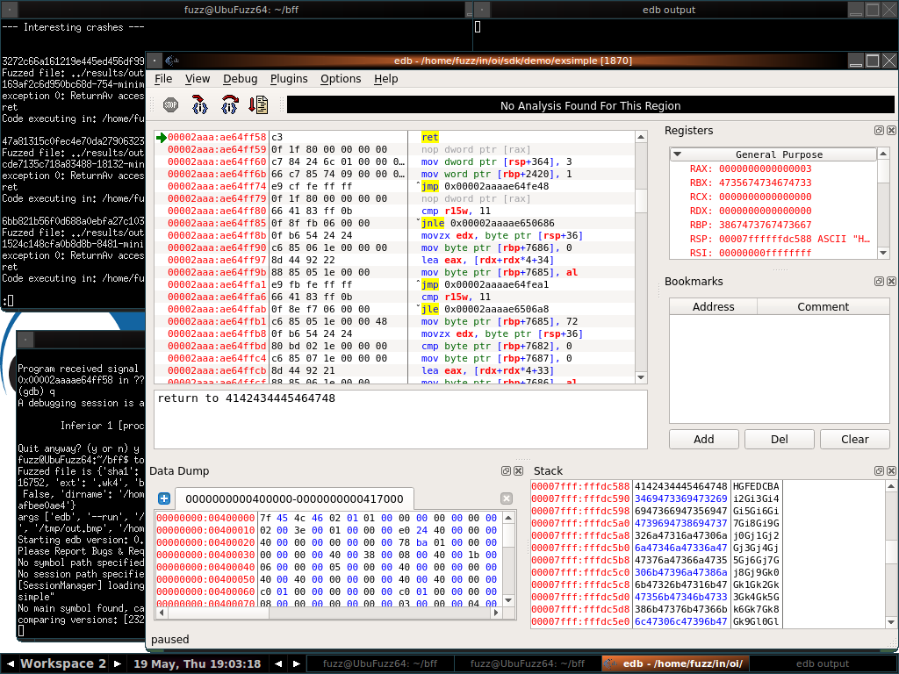
Minimization-to-string
Notes:
With the string-minimized crashing test case, it’s much more obvious. The stack is under my control, and I could use RSP to get there.

Slide 26
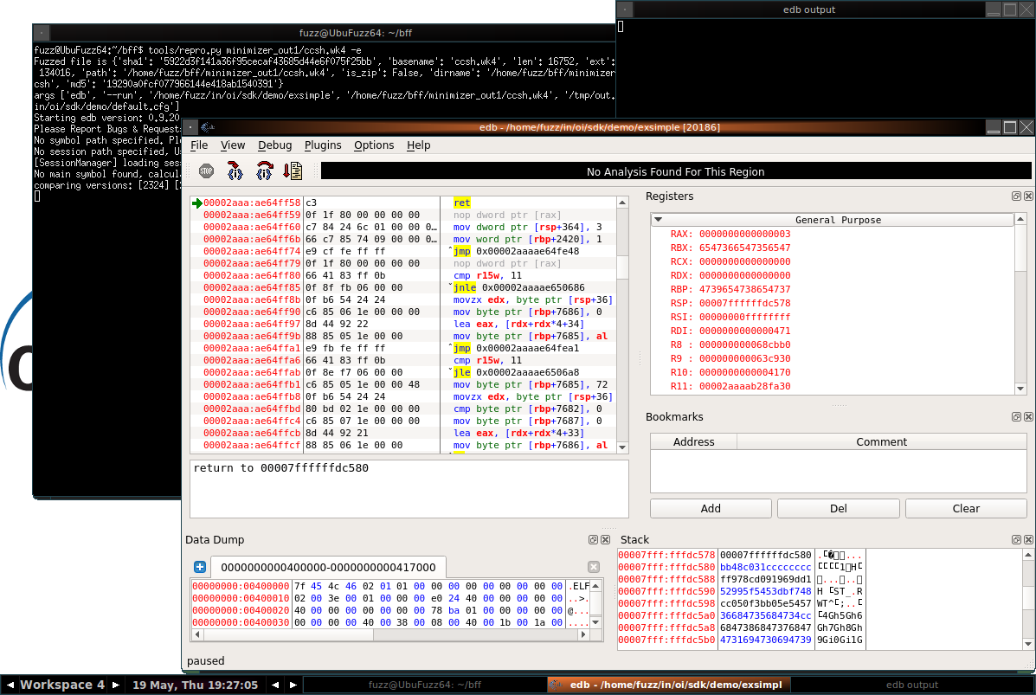
Return to the Stack
Notes:
Let’s try returning to the stack. We cheat a little here by using a fixed address. But it’s best to start simple and go from there.

Slide 27
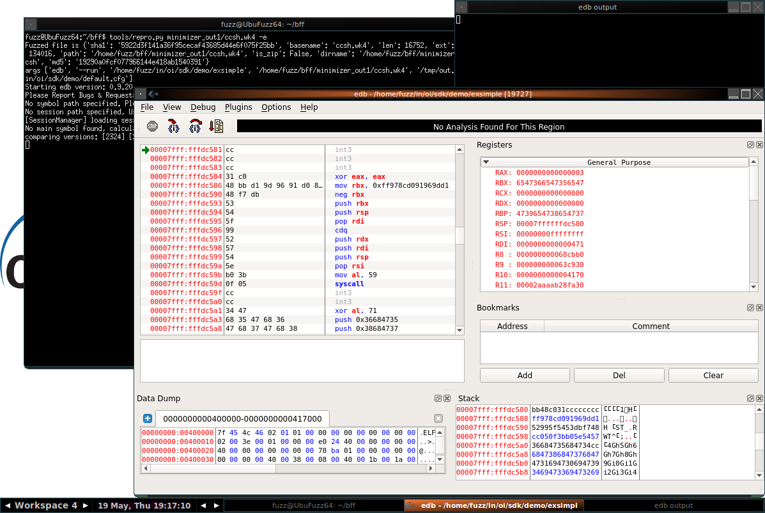
The Shellcode
Notes:
Here we look at the bytes that we’d be returning into. This is our shellcode, with some INT3s to make sure that the debugger engages.

Slide 28
Return to the Stack
Notes:
Let’s continue through the RET instruction

Slide 29
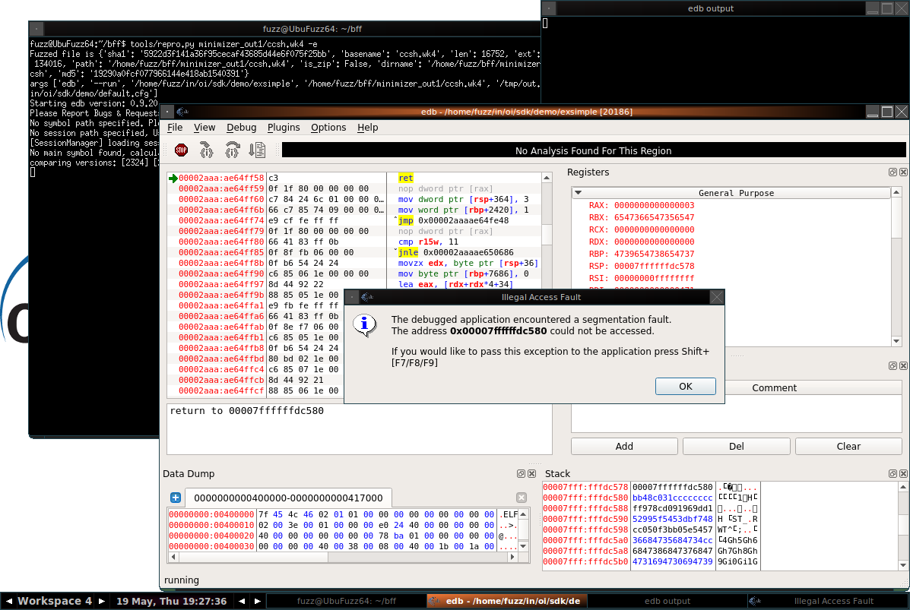
What’s Going On Here?
Notes:
We get an access violation on our return instruction. But the memory location is fine. We just saw the shellcode bytes at that address. What’s happening?

Slide 30
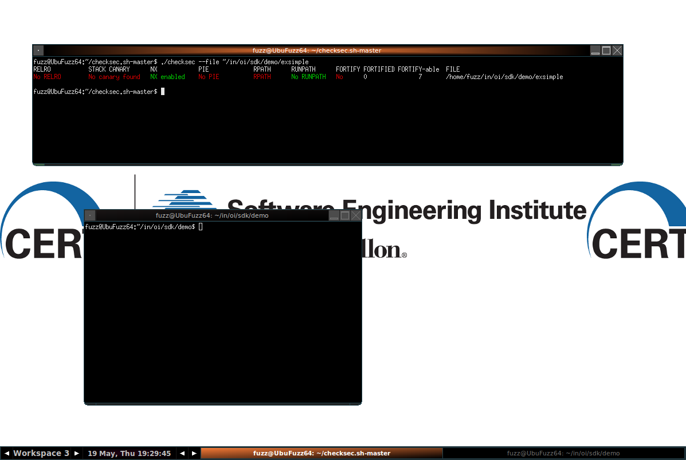
checksec.sh
Notes:
We can use checksec.sh <http://www.trapkit.de/tools/checksec.html> to see the exploit mitigations that are used by an app on Linux. Here we can see that NX is enabled.

Slide 31
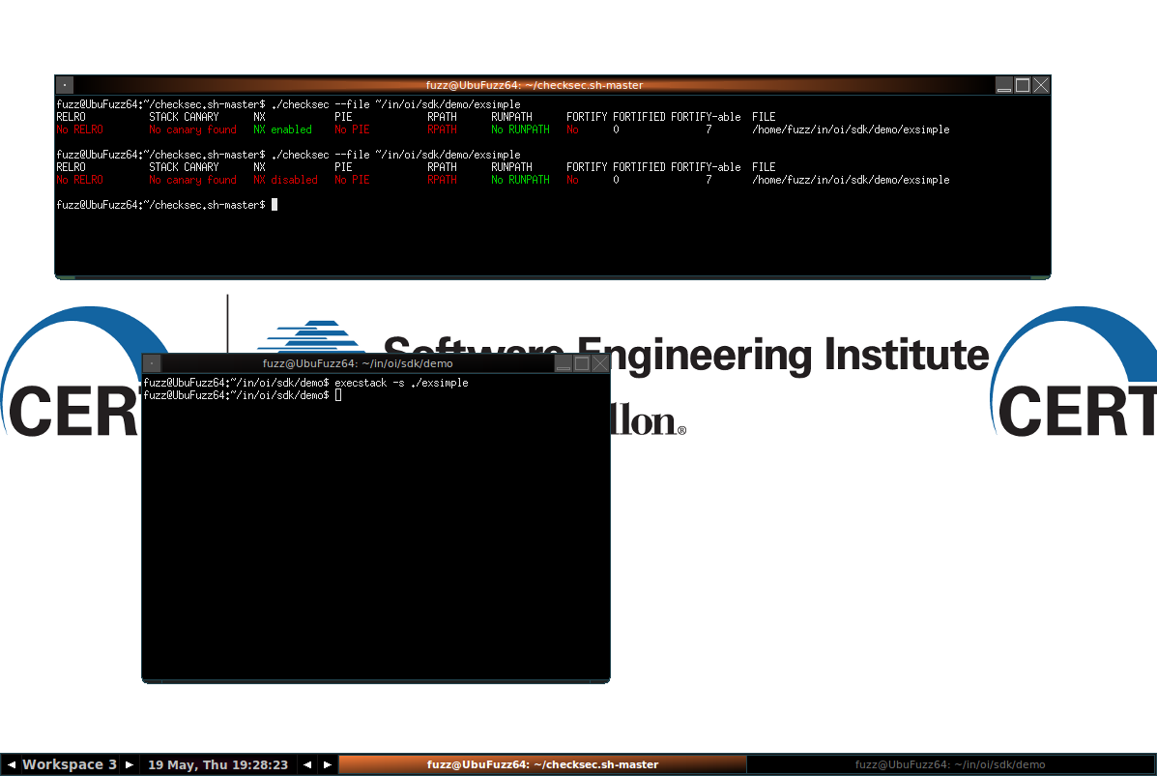
checksec.sh
Notes:
For testing purposes we can temporarily disable NX, using the execstack command.

Slide 32
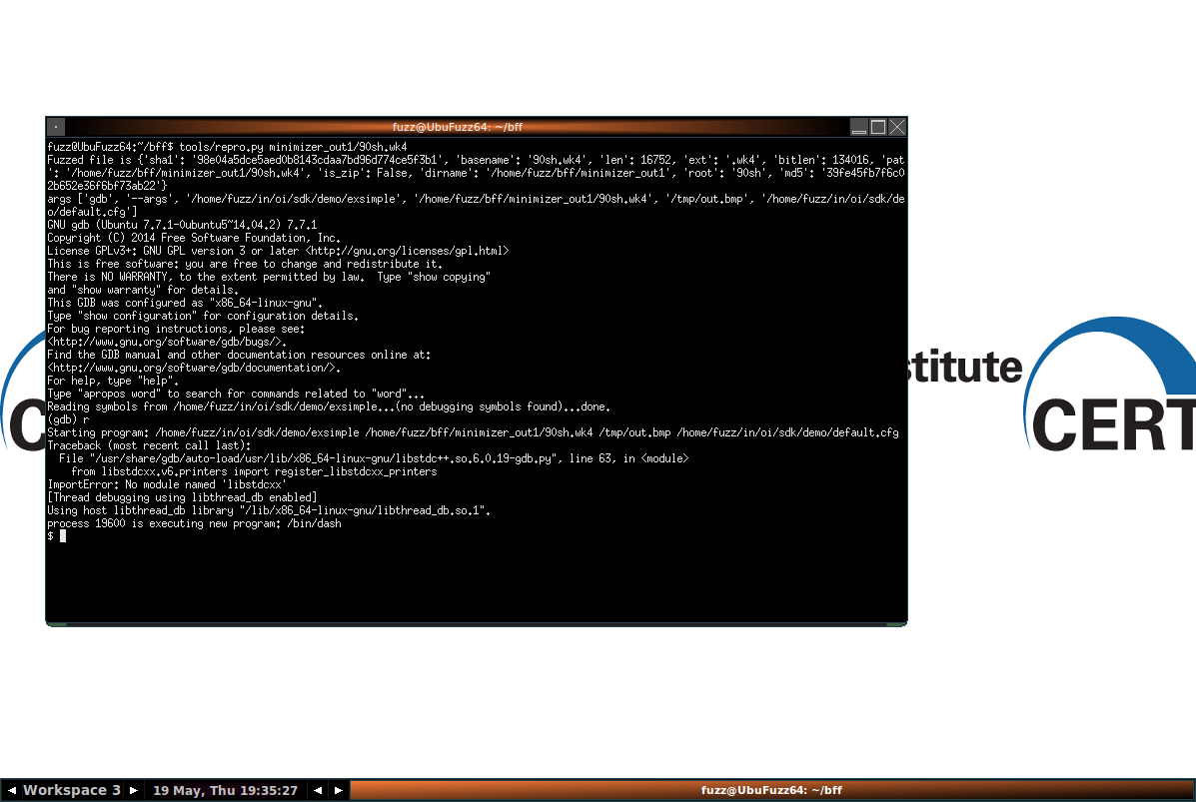
Success!
Notes:
Once we try again with NX disabled, we can see that our shellcode worked. In our case, it’s a simple spawning of /bin/sh (see last two lines for evidence, resulting in $)

Slide 33
CERT BFF
Return-Oriented Programming

Slide 34
Bypassing NX
NX (or DEP on Windows): Only memory pages marked as executable can be executed.
Return-oriented programming: Chain together pieces of executable code to achieve your goal. Each piece is connected via a RETURN instruction (or equivalent)
Notes:
How can we make our PoC work on a stock version of exsimple, which has NX enabled. We can use ROP to bypass NX. Put simply, we just re-use existing pieces of executable code to achieve the same outcome of our shellcode. Since we’re using executable code bits, NX won’t come into play.

Slide 35
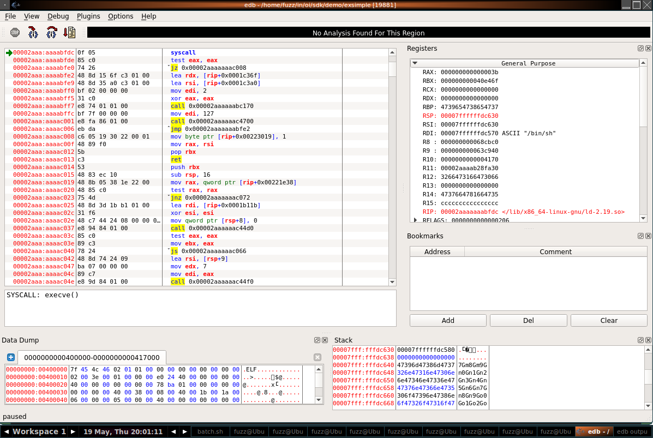
What Does My Shellcode Need?
Set RAX to 0x3B : execve()
Set RDX to NULL
Set RDI to pointer to “/bin/sh”
Set RSI to pointer to pointer to “/bin/sh”
Perform SYSCALL
Notes:
Looking at the shellcode that we tried earlier, we can see several things are necessary:
Set RAX to 0x3B : execve()
Set RDX to NULL
Set RDI to pointer to “/bin/sh”
Set RSI to pointer to pointer to “/bin/sh”
Perform SYSCALL

Slide 36
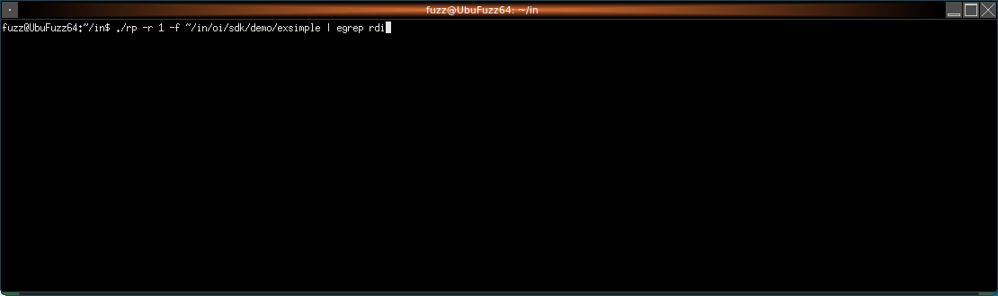
Finding Gadgets With rp++
Notes:
rp++ <https://github.com/0vercl0k/rp> is one of several tools that can statically extract potential gadgets from target apps. Here we look for gadgets that involve the RDI register.

Slide 37
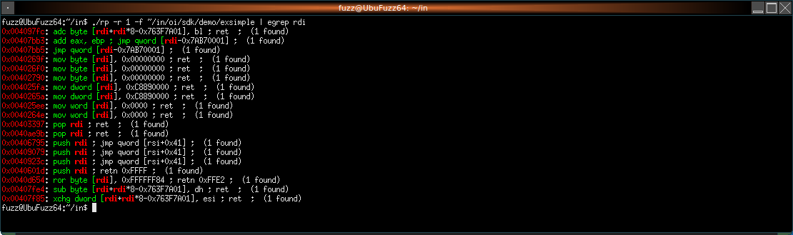
Finding Gadgets With rp++
Notes:
Here we see at least one trivial gadget that gets us control of RDI via a POP.

Slide 38
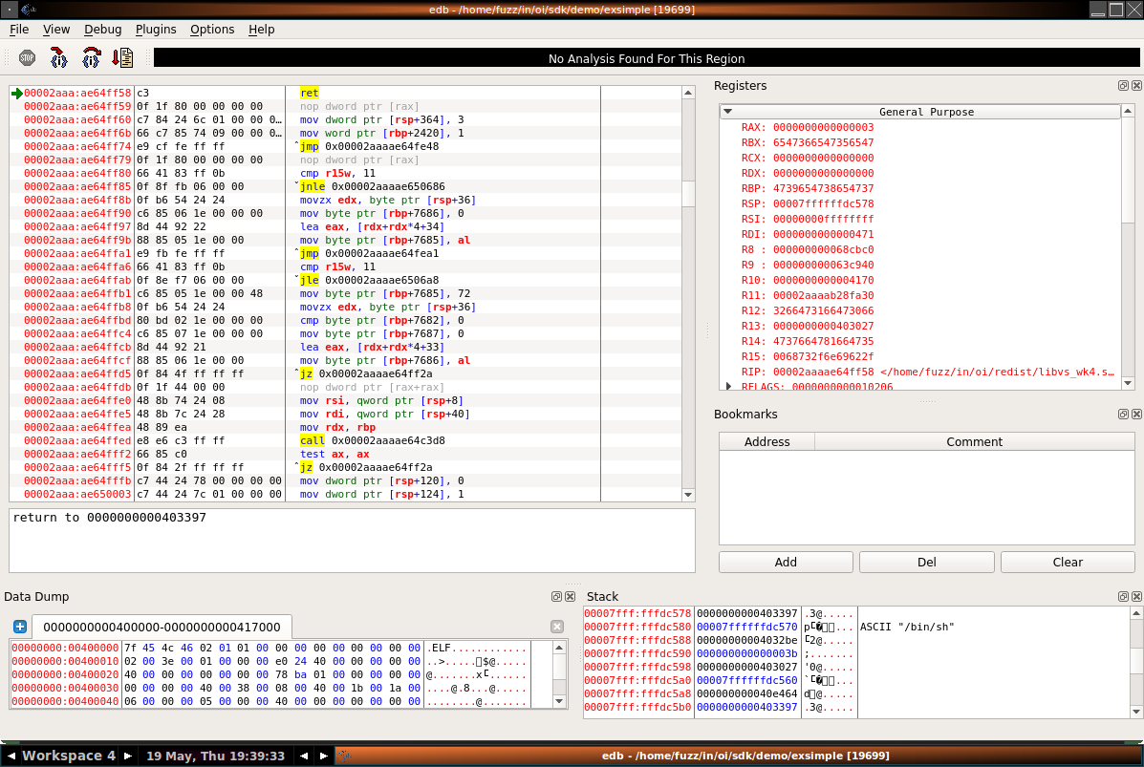
Tracing Into First Gadget
Notes:
We replace the address used by the RET instruction with the address of our gadget found with rp++ and then trace into it

Slide 39
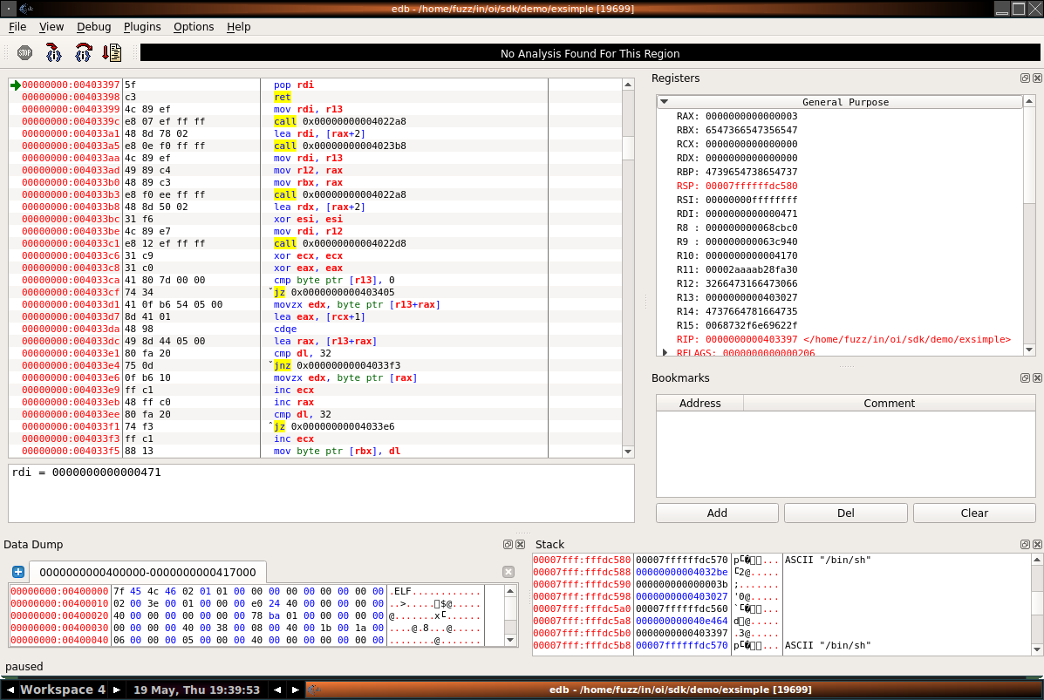
Tracing Into First Gadget
Notes:
Here’s our POP

Slide 40

Gadget Success!
Notes:
And RDI now contains the value that we specified. In our case, it’s a pointer to the ASCII string “/bin/sh”

Slide 41
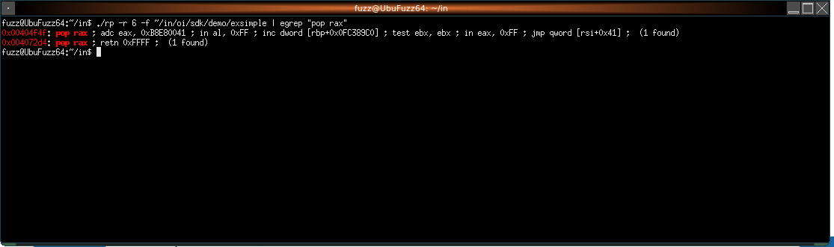

Now to set RAX
POP RAX should do it
Notes:
We also need control of RAX. Let’s look again with rp++. No such luck!

Slide 42
Never Give Up!
0x004032be: pop r13 ; ret ; (1 found)
RAX
RBX
RCX
RDX
RSI
RDI
R13
R14
R15
Notes:
Let’s not give up so easily. POP RAX isn’t the only way to get control of RAX. There are other instructions that can achieve the same goal. Or multiple gadgets that can be used in conjunction to achieve the same outcome.
Through trial and error, I was able to find a sequence that gives us control of RAX. Starting with R13…

Slide 43
Never Give Up!
0x004032be: pop r13 ; ret ; (1 found)
RAX
RBX
RCX
RDX
RSI
RDI
R13
R14
R15
Notes:
We now have control of R13

Slide 44
Never Give Up!
0x004032be: pop r13 ; ret ; (1 found)
0x00403027: pop rbx ; ret ; (1 found)
RAX
RBX
RCX
RDX
RSI
RDI
R13
R14
R15
Notes:
And we can also get control of RBX

Slide 45
Never Give Up!
0x004032be: pop r13 ; ret ; (1 found)
0x00403027: pop rbx ; ret ; (1 found)
RAX
RBX
RCX
RDX
RSI
RDI
R13
R14
R15

Slide 46
Never Give Up!
0x004032be: pop r13 ; ret ; (1 found)
0x00403027: pop rbx ; ret ; (1 found)
0x0040e464: mov rdx, r13 ; mov rsi, r14 ; mov edi, r15d ; call qword [rbx] ; (1 found)
RAX
RBX
RCX
RDX
RSI
RDI
R13
R14
R15
Notes:
This gadget is more complicated. First we move R13 into RDX

Slide 47
Never Give Up!
0x004032be: pop r13 ; ret ; (1 found)
0x00403027: pop rbx ; ret ; (1 found)
0x0040e464: mov rdx, r13 ; mov rsi, r14 ; mov edi, r15d ; call qword [rbx] ; (1 found)
RAX
RBX
RCX
RDX
RSI
RDI
R13
R14
R15
Notes:
Then we move R14 into RSI. But since we didn’t set R14, this means that RSI will be clobbered.

Slide 48
Never Give Up!
0x004032be: pop r13 ; ret ; (1 found)
0x00403027: pop rbx ; ret ; (1 found)
0x0040e464: mov rdx, r13 ; mov rsi, r14 ; mov edi, r15d ; call qword [rbx] ; (1 found)
RAX
RBX
RCX
RDX
RSI
RDI
R13
R14
R15
Notes:
RDI will also get clobbered, as we didn’t already have control of R15.

Slide 49
Never Give Up!
0x004032be: pop r13 ; ret ; (1 found)
0x00403027: pop rbx ; ret ; (1 found)
0x0040e464: mov rdx, r13 ; mov rsi, r14 ; mov edi, r15d ; call qword [rbx] ; (1 found)
RAX
RBX
RCX
RDX
RSI
RDI
R13
R14
R15
Notes:
Finally we end up with a CALL to [RBX]. But wait, this doesn’t end with a RET instruction. What gives? As it turns out, we have control over RBX, so we can just make sure that RBX points to a memory location that will allow our ROP to continue. For example, a RET instruction.

Slide 50
Never Give Up!
0x004032be: pop r13 ; ret ; (1 found)
0x00403027: pop rbx ; ret ; (1 found)
0x0040e464: mov rdx, r13 ; mov rsi, r14 ; mov edi, r15d ; call qword [rbx] ; (1 found)
0x00402867: mov eax, edx ; ret ; (1 found)
RAX
RBX
RCX
RDX
RSI
RDI
R13
R14
R15
Notes:
Finally, we move EDX into EAX.

Slide 51
Never Give Up!
0x004032be: pop r13 ; ret ; (1 found)
0x00403027: pop rbx ; ret ; (1 found)
0x0040e464: mov rdx, r13 ; mov rsi, r14 ; mov edi, r15d ; call qword [rbx] ; (1 found)
0x00402867: mov eax, edx ; ret ; (1 found)
RAX
RBX
RCX
RDX
RSI
RDI
R13
R14
R15
Notes:
This means that we’ve now set RAX (or at least the relevant 32-bit half of it) to a value that we control.

Slide 52
Success!
0x004032be: pop r13 ; ret ; (1 found)
0x00403027: pop rbx ; ret ; (1 found)
0x0040e464: mov rdx, r13 ; mov rsi, r14 ; mov edi, r15d ; call qword [rbx] ; (1 found)
0x00402867: mov eax, edx ; ret ; (1 found)
In 4 gadgets we achieved our goal of setting RAX to an arbitrary value
However:
  We clobber RSI
  We clobber RDI
RAX
RBX
RCX
RDX
RSI
RDI
R13
R14
R15
Notes:
Our selection of gadgets has collateral damage.

Slide 53
Properties of Gadgets
What it achieves (e.g. populate a register)
Collateral:
  What memory it must be able to read from
  What memory it must be able to write to
Notes:
Any gadget has a number of properties. Including what it does, but also importantly:
1 – What memory it must be able to dereference and read from
2 – What memory it must be able to dereference and write to

Slide 54
The Possibilities are Limitless
Sure you can do this all by hand, with trial and error. Or:
Q: Exploit Hardening Made Easy
https://users.ece.cmu.edu/~ejschwar/papers/usenix11.pdf
Notes:
This example was pretty simple, but it was also a bit of manual work involving trial and error. Some research has been done into making this process more automated, using solvers.

Slide 55
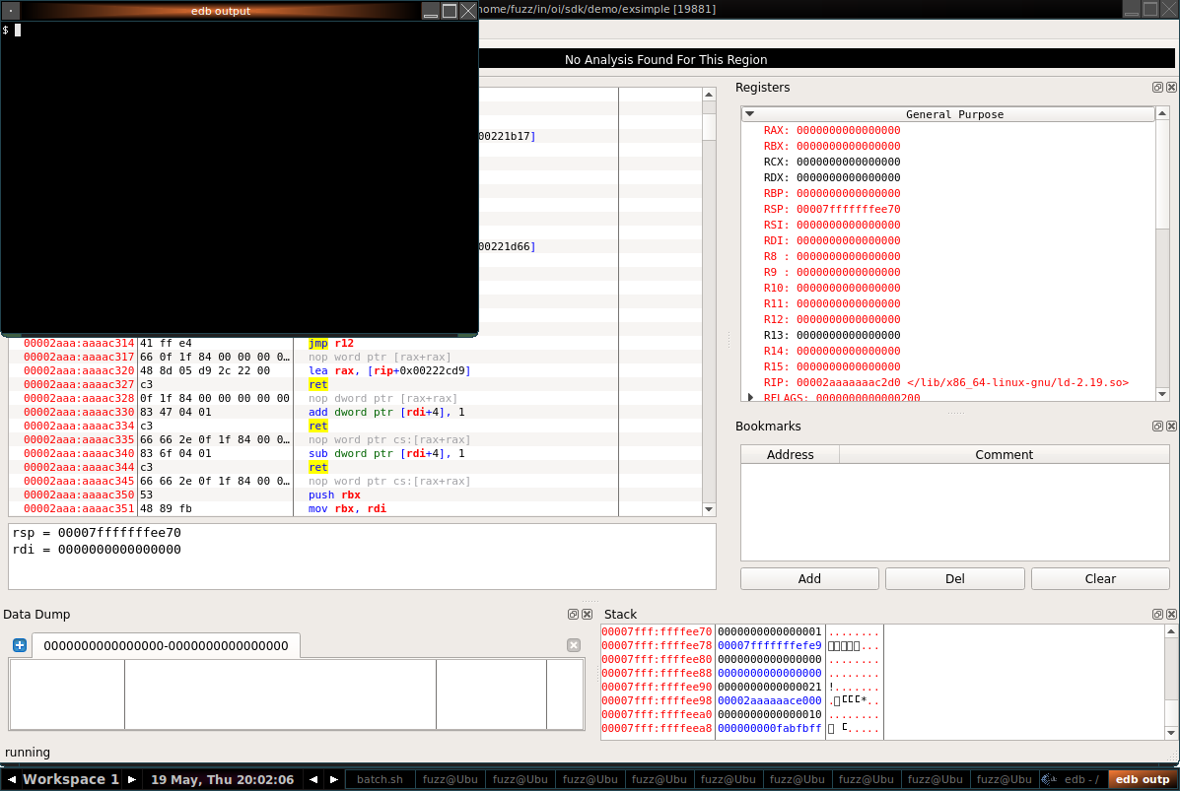
Putting All The Pieces Together
Notes:
Repeat the gadget search process for the other requirements. Remember that we need:
Set RAX to 0x3B : execve()
Set RDX to NULL
Set RDI to pointer to “/bin/sh”
Set RSI to pointer to pointer to “/bin/sh”
Perform SYSCALL
After re-enabling NX in our exsimple application, we run it (via edb, in case something goes wrong).
There’s our shell!

Slide 56
Get Your Own BFF
Mutational file fuzzing for Linux and OS X:
https://www.cert.org/vulnerability-analysis/tools/bff.cfm
Or FOE if Windows is your thing:
https://www.cert.org/vulnerability-analysis/tools/foe.cfm
Notes:
You can get BFF to start fuzzing on your own. Or if you are targeting Windows, you’ll want FOE. Both tools are free!
The next version of BFF will work on all three platforms, making FOE deprecated.

Slide 57
Contact Information
Presenter / Point of Contact Will Dormann Senior Vulnerability Analyst Email: wd@cert.org Twitter: @wdormann CERT Coordination Center Email: cert@cert.org Twitter: @certcc

